Slide 1
*{OPENING A RESTAURANT}*
PITCH BY-TANUJ KUMAR

Slide 2
* AGENDA *
Finalize a concept
Write a business plan
Select location
Get Overview of the markets
Research and analyze this business
Choose a name
Get through of the other restaurant
Judgment

Slide 3

APPROACH:-
Decide the concept of the restaurant
Investment plan for opening a restaurant
Survey of the people
Decided the perfect location for the restaurant
Required data collection to start the restaurant business
Processing the data for running the restaurant business
Design a stellar menu
Clean the data and analysis the data
Focus on marketing of the restaurant
Data modeling
Host a soft opening

Slide 4

QUESTIONNAIRE:-
We need to find out a better place where we cover all places like; govt. sector, private sector, school and rest area as well.
What will your restaurant design look like?
How do I know the demand of that area, without knowing the demand we can’t be able to supply?
How much budget to make and start the restaurant?
What ordering system we want to use? ( Different type of peoples are living there like: Primitive, non-primitive, average, below-average)
What accounting and payroll system we want to use?
What team do we need to run the restaurant?
How many people do we initially need to open the restaurant?
Where will we kept the source of food and equipment?
What customer service culture will create and how will we handle the customer complaints?

Slide 5

* KEY INFLUENCERS *
Private functions and events
Style of restaurant
Profession, Gender
Money spending tendency
Age group, Marital status
Monthly income
Dining frequency, Food preferences
Food choices, Buffet setup
Subscription based food services, Guest loyalty program
Overall feedback

Slide 6
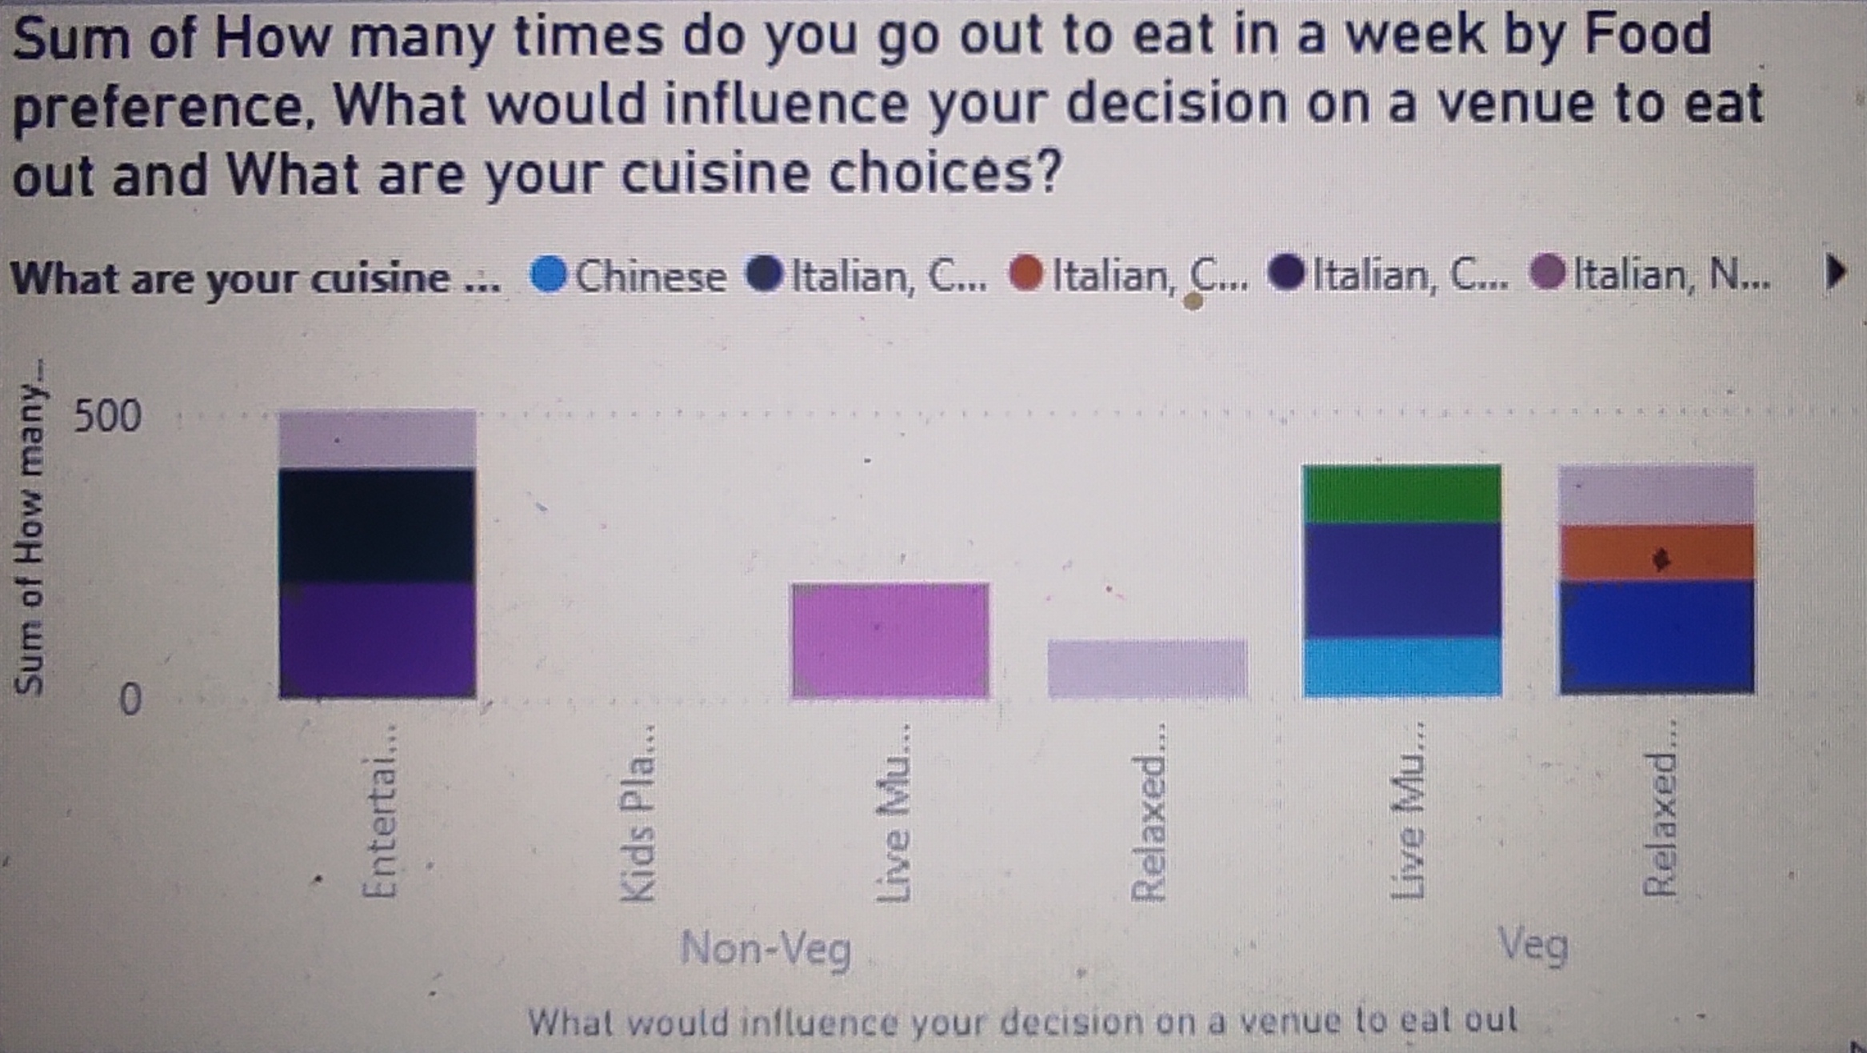
* PRESENTING BY CHARTS *

Slide 7
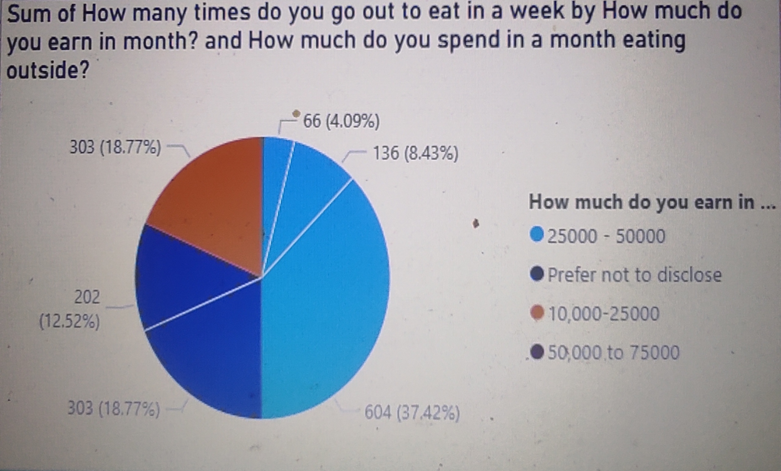
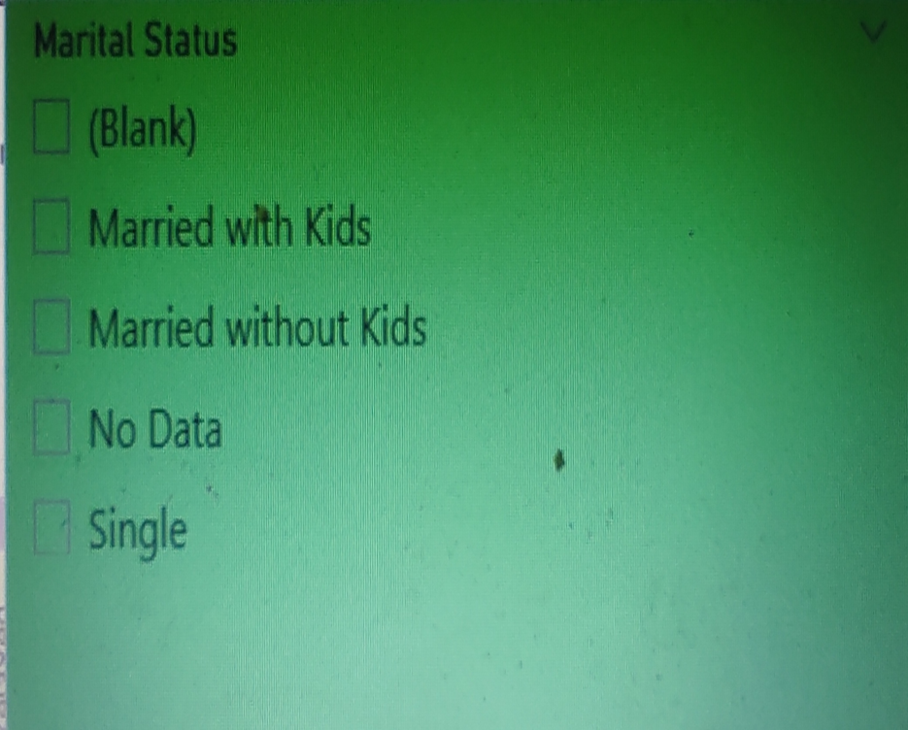
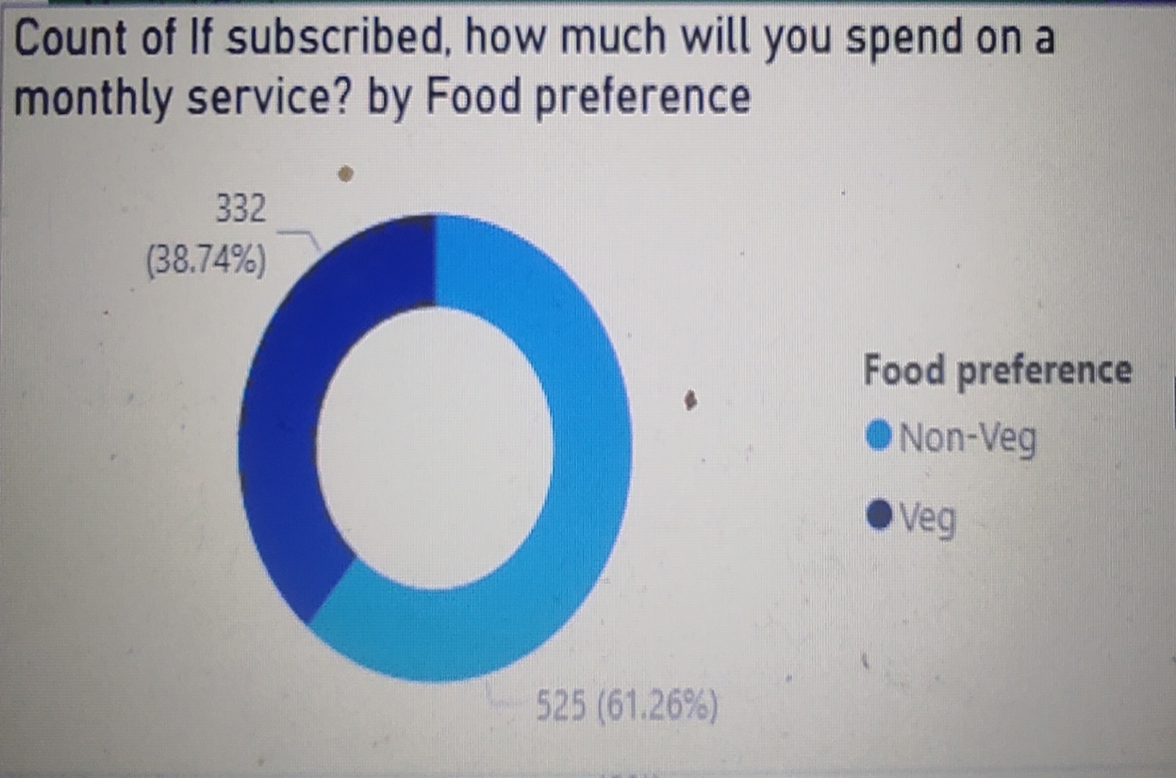
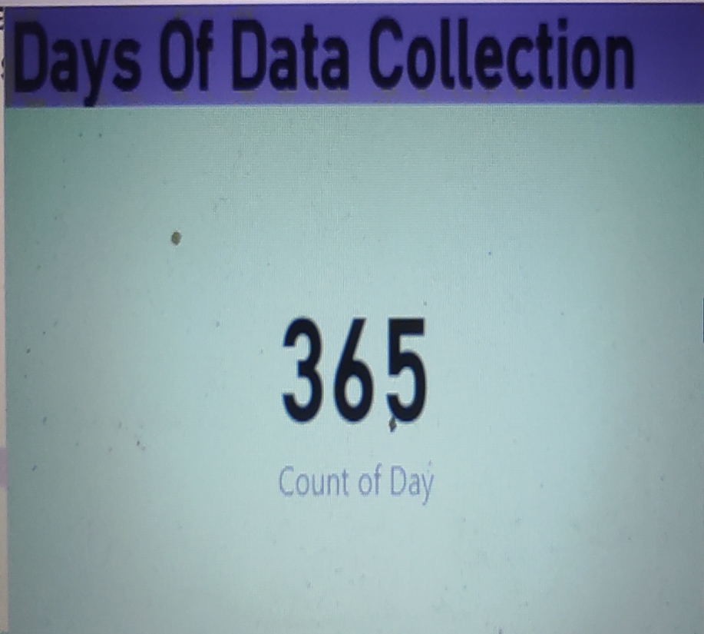

Slide 8
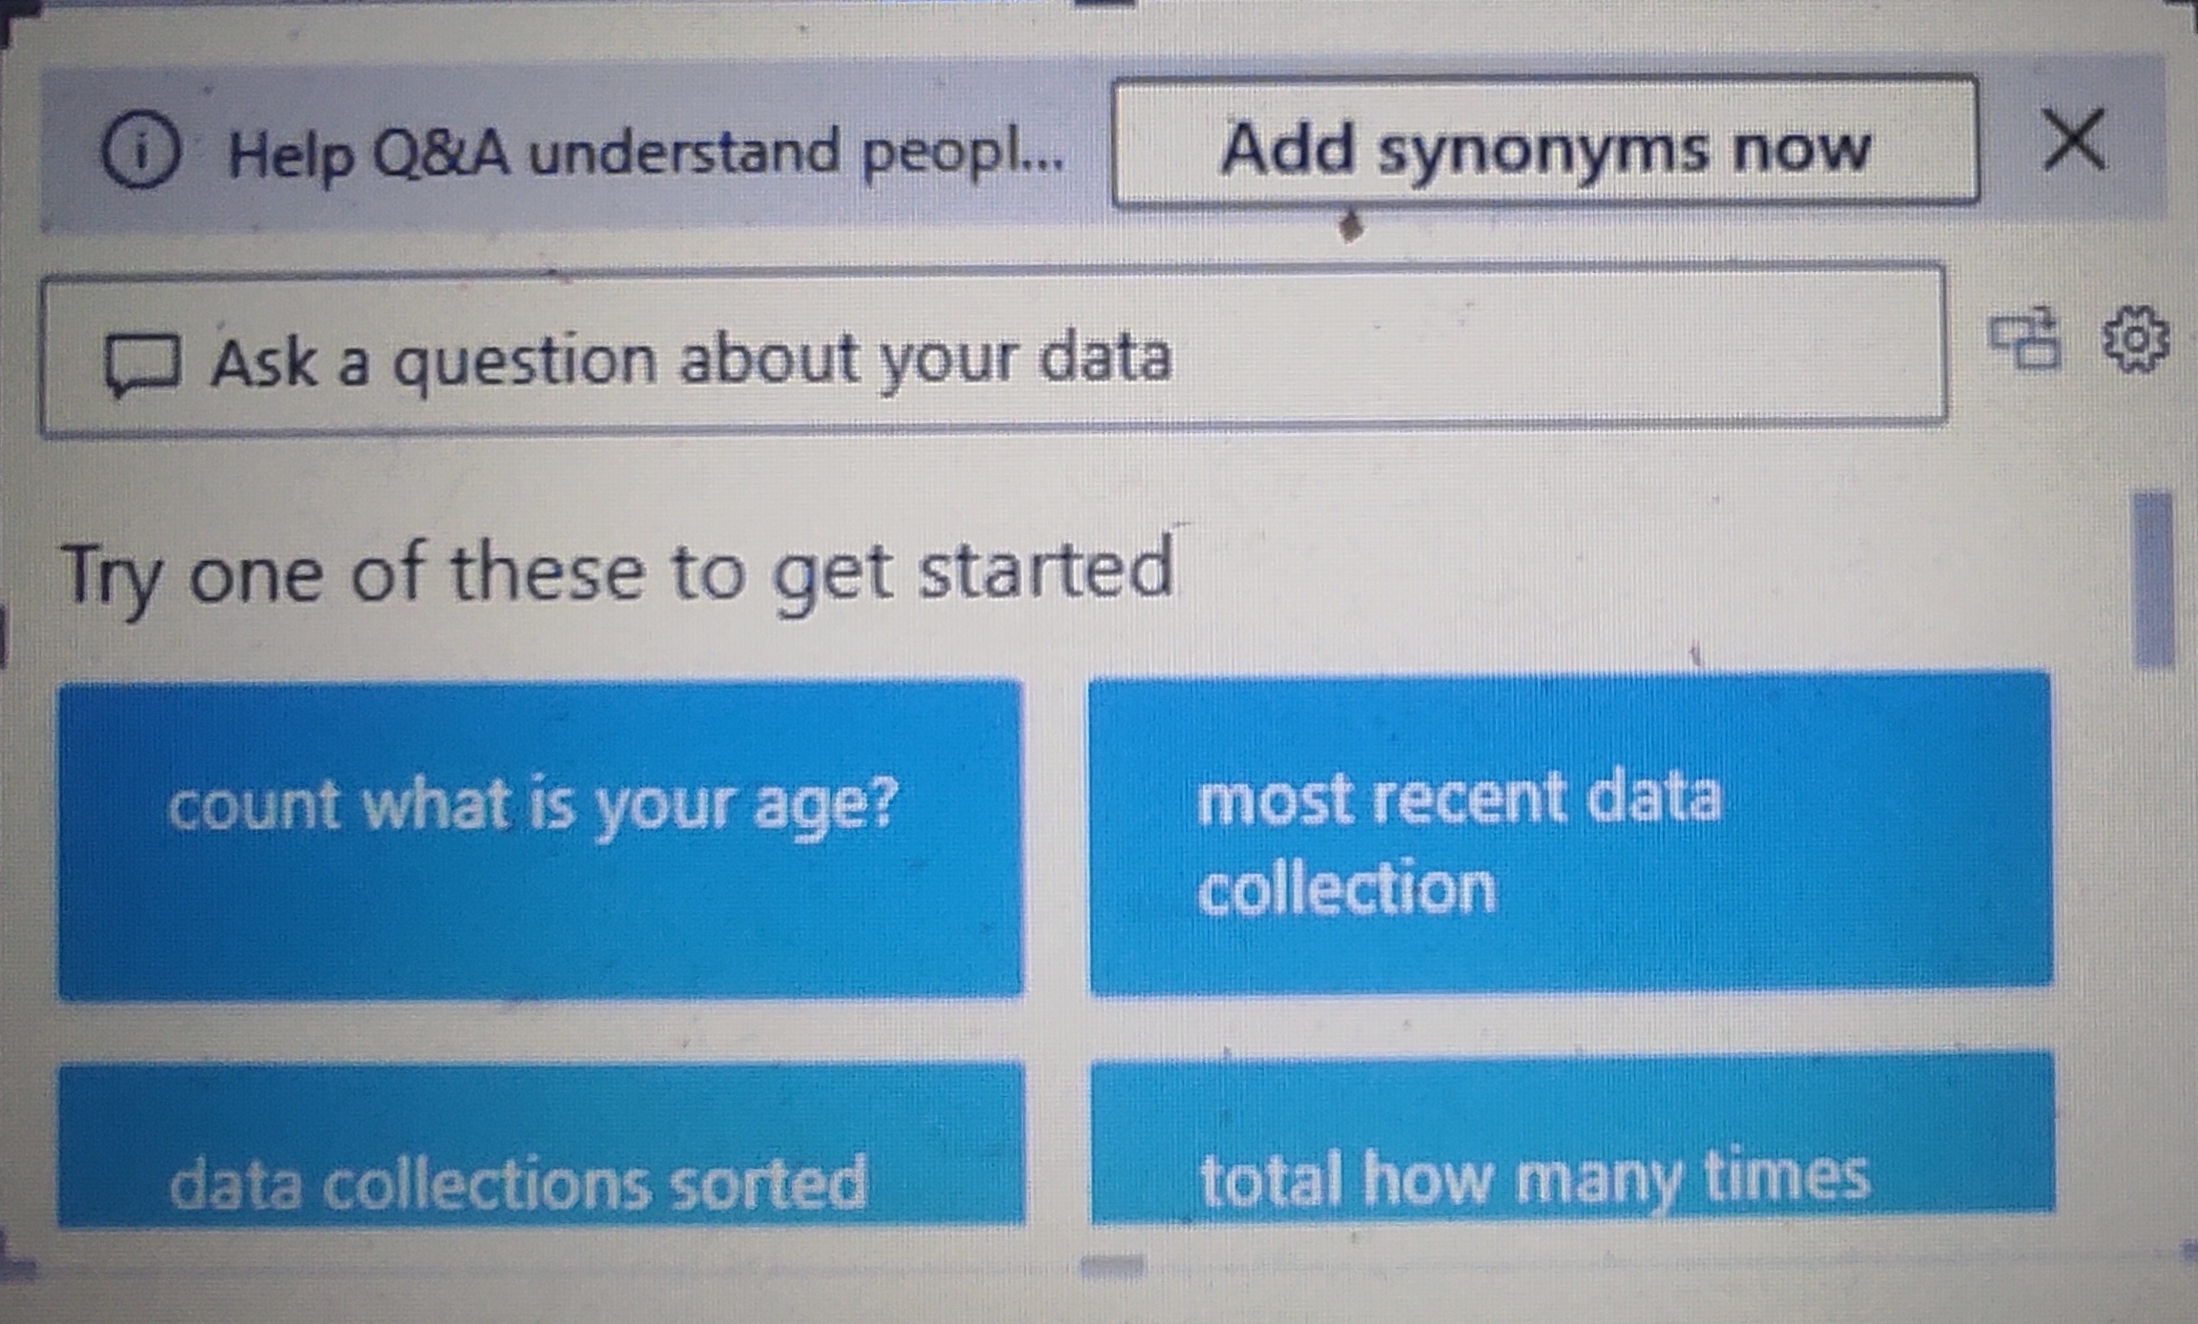

Slide 9

* INSIGHTS *
Entertainment and live music have more attractive choices among people
Restaurant and banquet setup with relaxed atmosphere is preferred by most
Most of the single likes non-veg.
More than 50% of the population consists of people with age between 15-35 and salary range between 25k-80k/month
Open roof is more demanding in single and without kids
Subscription based food services can be apply
Majority of people would love a restaurant to have space for private functions and events, parking services and buffet setup

Slide 10

* CONCLUSION *
In order to obtain the data questionnaire designed is also included. The analysis of data is also being made using charts and graphs. It can be concluded that the investment in restaurant will be profitable business. It’s a good opportunity to earn huge profits in this business.

Slide 11



